Slide 1
UNIT III
Linkers and Loaders
Software tools

Slide 2
Contents
Linkers and Loaders:
Basic loaders functions, central loaders scheme Absolute loaders, Subroutine linkers, relocation Loader, Direct linking loader, Dynamic linking loader, Design of absolute loaders direct linking loader, Implantation of MS DOS linker,
Software tools:
Software tools for program development, editors, debug monitor, programming environment, user interfaces.

Slide 3
A. LOADERS AND LINKERS
Loader is a program which accepts the object program decks, prepare these programs for execution by the computer, and initiates the execution.

Slide 4
Role of Loader
Source
Program
Assembler
Loader
Object
Program
Object program ready for execution

Slide 5
Role of Loader and Linker
Memory
Source
Program
Assembler
Linker
Object
Program
Object program ready for execution
Executable
Code
Loader

Slide 6
We know…
  Source Program – Assembly Language
  Object Program - From assembler
  - Contains translated instructions and data values from the source program
  Executable Code - From Linker
  Loader - Loads the executable code to the specified memory locations and code gets executed.

Slide 7
Basic Loader Functions
A Loader is a system program that performs the loading function
It brings object program into memory and starts its execution

Slide 8
Basic Functions
Allocation: allocate space in memory for the programs
Linking: Resolve symbolic references between object files
  combines two or more separate object programs
  supplies the information needed to allow references between them

Slide 9
Basic Functions
Relocation: Adjust all address dependent locations, such as address constants, to correspond to the allocated space
  modifies the object program so that it can be loaded at an address different from the location originally specified
Loading: Physically place the machine instructions and data into memory

Slide 10
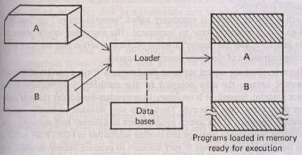
General loading scheme

Slide 11
Type of Loaders
“Compile-and-go” loader
General loader scheme
Absolute loader
Subroutine linkage
Relocating loader (relative loader)
Direct linking loader
A binder and a module loader
Dynamic loading
Dynamic linking
MS-DOS Linker

Slide 12
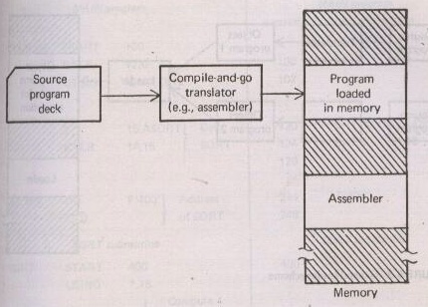
1. “Compile-and-go” loader

Slide 13
Disadvantages
A portion of memory is wasted because the memory occupied by the assembler is unavailable to the object program.
It is necessary to re-translate (assemble) the user's program file every time it is run.
It is very difficult to handle multiple segments, especially if the source programs are in different languages.

Slide 14
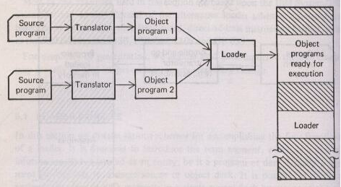
2. General loader scheme

Slide 15
3. Absolute Loader
Operation is very simple
The object code is loaded to specified locations in the memory
At the end the loader jumps to the specified address to begin execution of the loaded program

Slide 16
Role of Absolute Loader
Absolute
Loader
1000
Object
Program
Object program ready for execution
2000
Memory

Slide 17
Absolute Loader
Advantage
- Simple and efficient
Disadvantage
- the need for programmer to specify the actual address
- difficult to use subroutine libraries

Slide 18
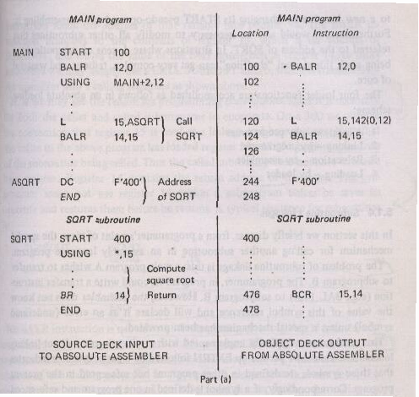
Absolute Loader

Slide 19
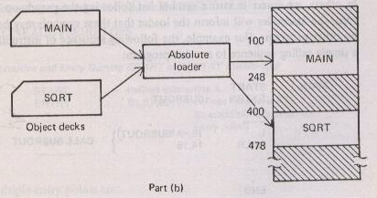
Absolute Loader

Slide 20
Disadvantages
If changes were made to MAIN that increased its length to more than 300 bytes
  the end of MAIN (at 100 + 300 = 400) would overlap the start of SQRT (at 400)
  It would then be necessary to assign SQRT to a new location
    changing its START and re-assembling it?!
Furthermore, it would also be necessarily to modify all other subroutines that referred to the address of SQRT.

Slide 21
Disadvantages of Absolute Loaders
Actual load address must be specified
The programmer must be careful not to assign two subroutines to the same or overlapping locations
Difficult to use subroutine libraries (scientific and mathematical) efficiently
  important to be able to select and load exactly those routines that are needed

Slide 22
Absolute Loader
Four functions are accomplished as
  Allocation – by programmer
  Linking – by programmer
  Relocation – by assembler
  Loading – by loader

Slide 23
Subroutine Linkages
The main program A wishes to transfer to subprogram B.
The programmer, in program A, could write a transfer instruction (e g, BSR B) to subprogram B.
The assembler does not know the value of this symbol reference and will declare it as an error

Slide 24
Externals and Entries
The assembler pseudo-op EXT followed by a list of symbols indicates that the symbols are defined in other programs but referenced in the present program
If a symbol is defined in one program and referenced in others,
  insert it into a symbol list following the pseudo-op ENT.

Slide 25
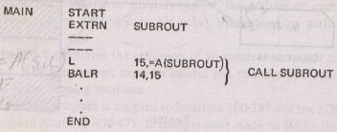

4. Subroutine linkage

Slide 26
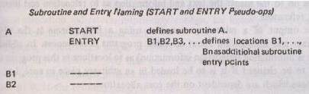
Subroutine linkage
Assembler linkage pseudo-ops
Uses of multiple entry points are
  Common coding
  Collecting together related routines for convenience
  Better or convenient access to common data base

Slide 27
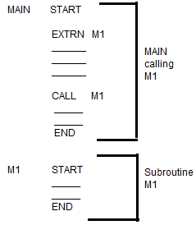
…contd..Subroutine Linkages
EXTRN Statements: they list the SYMBOLS to which external references are made in current program unit
  These SYMBOLS are defined in other program unit
  Diagram shows MAIN and M1 in separate program units
  Assembler cannot provide address of external symbols
ENTRY Statements: they list the public definitions of a program unit
  Lists SYMBOLS defined the program unit which may be used in other program units
External symbols are UNRESOLVED until LINKING

Slide 28
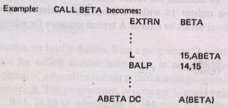
Subroutine linkage
Subroutine reference (EXTRN pseudo-op)

Slide 29
5. Relocating Loaders
To avoid possible reassembling of all subroutines when a single subroutine is changed , relocating Loader is used.
Efficient sharing of the machine with larger memory and when several independent programs are to be run together
Support the use of subroutine libraries efficiently

Slide 30
Perform task of allocation & linking for programmer this loader is introduced
It allows the programmer multiple procedure segments and single data segments

Slide 31
Relocation
Compilers and assemblers generate the object code for each input module with a starting address of zero (Generally)
Relocation is the process of assigning load addresses to different parts of the program by merging all sections of the same type into one section. The code and data section also are adjusted so they point to the correct runtime addresses.

Slide 32
What is RELOCATION?
Process of modifying the addresses used in the “address sensitive instructions” so that the program executes correctly from any designated area of the memory
  Sample of (memory) address sensitive instruction:-
MOVER AREG, X
BC ANY, L1

Slide 33
Meaning of these 3 Origins : Translated, Linked and Loaded
Translated Origin :
  Address specified by Programmer (ORIGIN)
Linked Origin:
  Address specified by Linker when producing the machine code
Loaded Origin:
  Address specified by Loader when loading program for execution

Slide 34
Relocation
Relocating loaders or relative loaders:
  loaders that allow for program relocation.
Two methods for specifying relocation as part of the object program:
1. A Modification record
  describe each part of the object code that must be changed when the program is relocated

Slide 35
Second Method
Bit mask: A relocation bit/byte associated with each word of object code
  S for Absolute: does not need modification
  R for Relative: needs relocation
  X for external.

Slide 36
Relocating Loaders
Allocating subroutines to prevent reassembling the code every time a subroutine changes
Binary Symbolic Subroutine (BSS) Loader
  The program length information is for allocation.
  Bit Mask is used for relocation
  The transfer vector is used to solve the problem of linking

Slide 37
…contd..Relocation concepts
Program Relocatability : Ability to load and execute program in into arbitrary location in memory
2 basic type of relocation: (Based on when mapping of virtual address to physical address is done)
  Static Relocation
  Dynamic Relocation

Slide 38
Binary Symbolic Subroutine Loader
The assembler assembles Provides the loader
  Object program + relocation information
  Prefixed with information about all other program it references (transfer vector).
  The length of the entire program
  The length of the transfer vector portion

Slide 39
Transfer Vector
A transfer vector consists of
  addresses containing names of the subroutines referenced by the source program
  if a Square Root Routine (SQRT) was referenced and was the first subroutine called, the first location in the transfer vector could contain the symbolic name SQRT.
  The statement calling SQRT would be translated into a branch to the location of the transfer vector associated with SQRT

Slide 40
The loader
loads the text and the transfer vector
loads each subroutine identified in the transfer vector.
place a transfer instruction to the corresponding subroutine in each entry in the transfer vector.
  The execution of the call SQRT statement result in a branch to the first location in the transfer vector
  which contains a branch to the location of SQRT.

Slide 41
BSS Scheme Disadvantages
the transfer vector increases the size of the object program in memory
the BSS loader does not facilitate access to data segments that can be shared
  the transfer vector linkage is only useful for transfers
  not well suited for loading or storing external data (data located in another procedure segment)

Slide 42
6. Direct linking loader
A general relocatable loader
It allows the programmer multiple procedure segments and multiple data segments and gives complete freedom in referencing data or instructions contained in other program
It provides flexible intersegment referencing and accessing ability, while at the same time allowing independent translations of programs

Slide 43
Direct Linking Loader
The assembler provides
  The length of segment
  A list of all entries and their relative location within the segment
  A list of all external symbols
  Information as to where address constants are loaded in the segment and a description of how to revise their values.
  The machine code translation of the source program and the relative addresses assigned

Slide 44
Direct-linking loader
Four sections of the object deck
  External Symbol Dictionary cards (ESD)
  Instructions and data cards, called “text” of program (TXT)
  Relocation And Linkage Directory cards (RLD)
  End card (END)

Slide 45
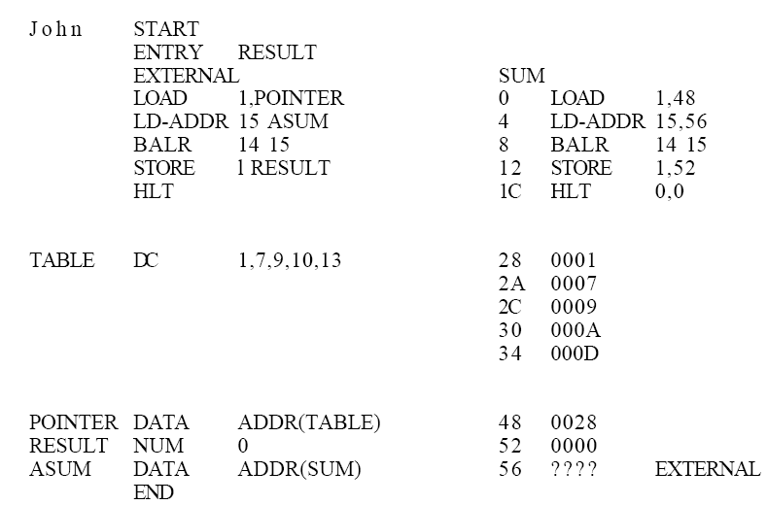
Example

Slide 46
Assembler records
External Symbol Dictionary (ESD) record: Entries and Externals
(TXT) records control the actual object code translated version of the source program.
The Relocation and Linkage Directory (RLD) records relocation information
The END record specifies the starting address for execution

Slide 47
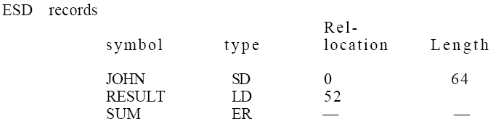
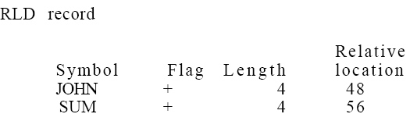
ESD and RLD
SD: Segment Definition
Local Definition
External Reference

Slide 48
Disadvantages of Direct Linking
It is necessary to allocate, relocate, link, and load all of the subroutines each time in order to execute a program
  loading process can be extremely time consuming.
Though smaller than the assembler, the loader absorbs a considerable amount of space
  Dividing the loading process into two separate programs a binder and a module loader can solve these problems.

Slide 50
A binder and a module loader
Classes of binders
  Core image builder
    The specific core allocation of the program is performed at the time that the subroutines are bound together.
  Linkage editor
    Can keep track of the relocation information so that the resulting load module, can be further relocated & loaded anywhere in core.

Slide 51
Linking Loader : performs linking and relocation at load time
Other alternatives
Linkage editors: which performs linking prior to load time
Dynamic linking: where linking function is performed at execution time

Slide 52
7. A binder and a module loader
A binder is a program that performs the same functions as the direct-linking loader in “binding” subroutines together, but rather than placing the relocated and linked text directly into memory, it outputs the text as a file or card deck.
This output file is in a format ready to be loaded which is called as load module.
The binder essentially performs the functions of allocation, relocation, and linking; the module loader performs the function of loading.
A sophisticated binder is linkage editor

Slide 53
Dynamic loading
In order for overlay structure to work it is necessary for the module loader to load the various procedures as they are needed.
The portion of the loader that actually intercepts the “calls” and loads the necessary procedure is called the overlay supervisor or flipper.
This overall scheme is called dynamic loading or load-on-call (LOCAL).

Slide 54
Overlay Structures
What is Overlay?
  Part of a program which has same load origin, as some other part of program
When is it used?
  When system does not support virtual memory
  And static linking/loading requires all subroutines to be in main memory at the same time
  And total memory required exceeds the amount available

Slide 55
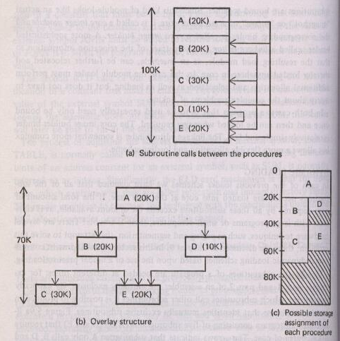
8. Dynamic loading

Slide 56
9. Dynamic linking
Loading and linking of external references are postponed until execution time
Assembler produces text, binding and relocation information from a source language deck.
The loader loads only the main program.

Slide 57
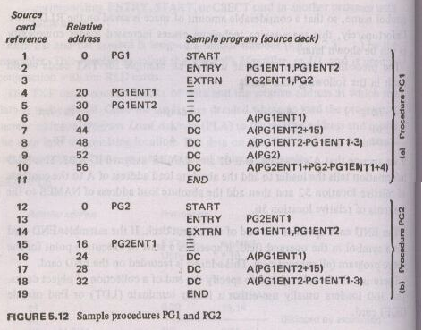
Example of a Direct-linking loader

Slide 58
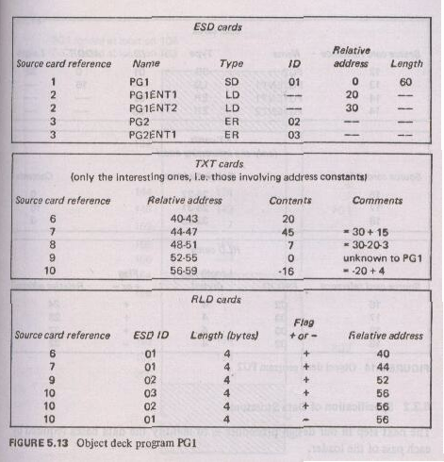
Example of Direct-linking loader

Slide 59
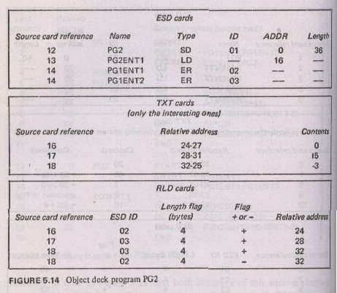
Example of a Direct-linking loader

Slide 60
TRUEorFALSE
1.In absolute loader linking is done by programmer.
2. In compile and go loader linking is performed by loader.
3 loader loads & executes object program.

Slide 61
Comment
Static linking Dynamic linking
Static binding leads to more efficient execution of a program than dynamic bindings.
Why are library routines usually relocatable ?
What would happen if these routines are made
Non relocatable?

